Slide 1
Metabolic dysfunction is associated with alterations in gut microbiota in an obese adolescent cohort
Quin Xie
PhD candidate, Lab of Dr. Jayne Danska
James Lepock Memorial Symposium
2024
Notes:
Relationship between metabolic dysfunction & microbiota alteration in an obese adolescent cohort

Slide 2
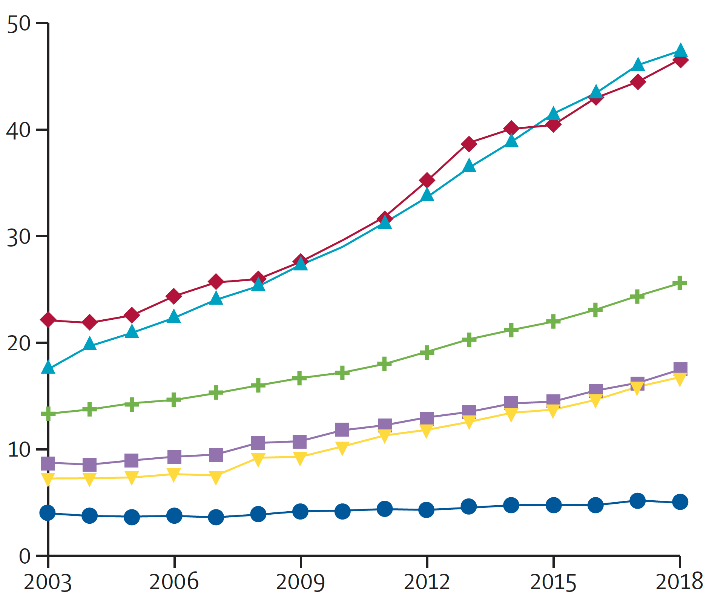
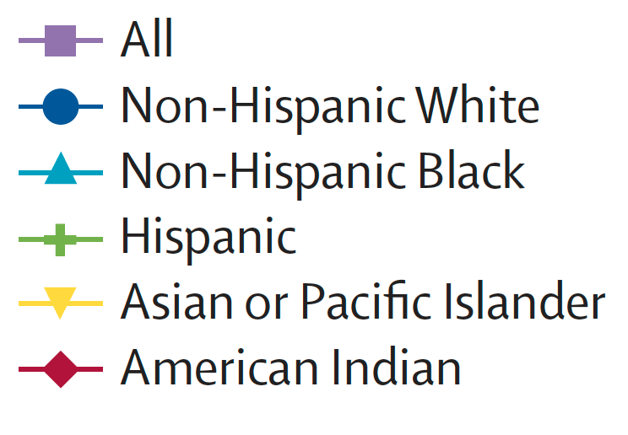
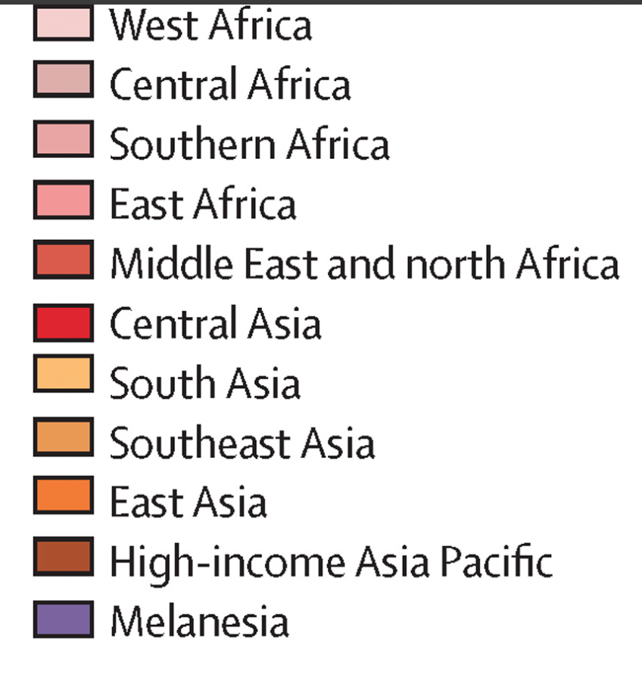
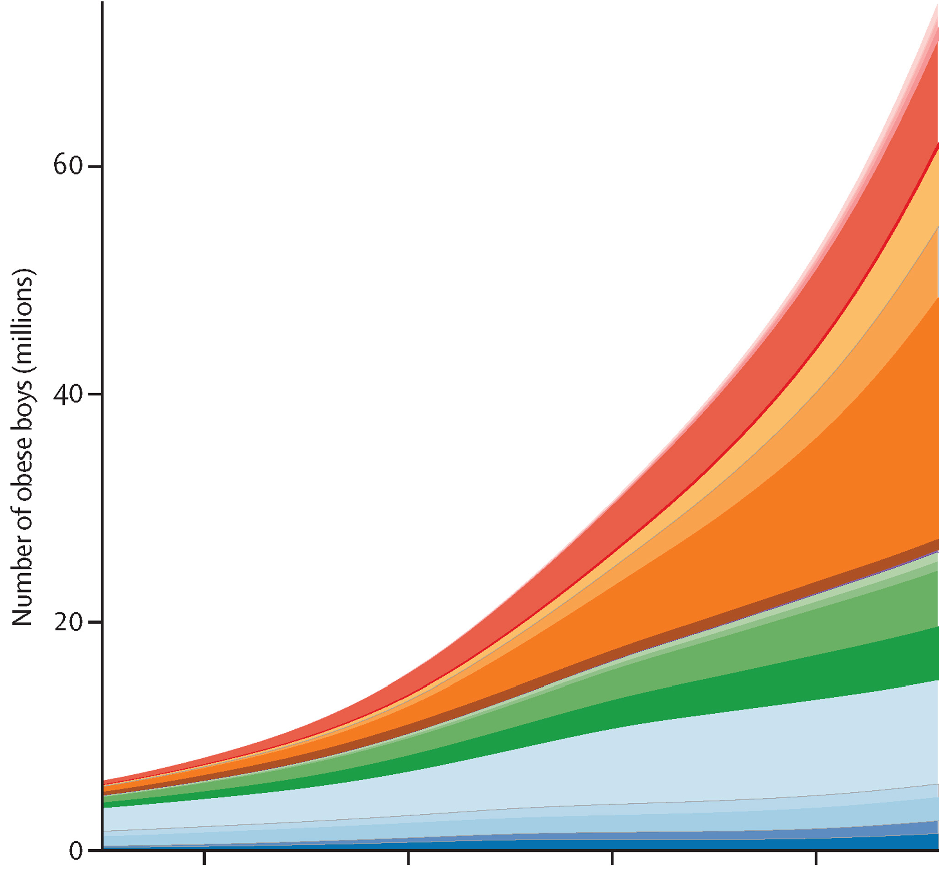
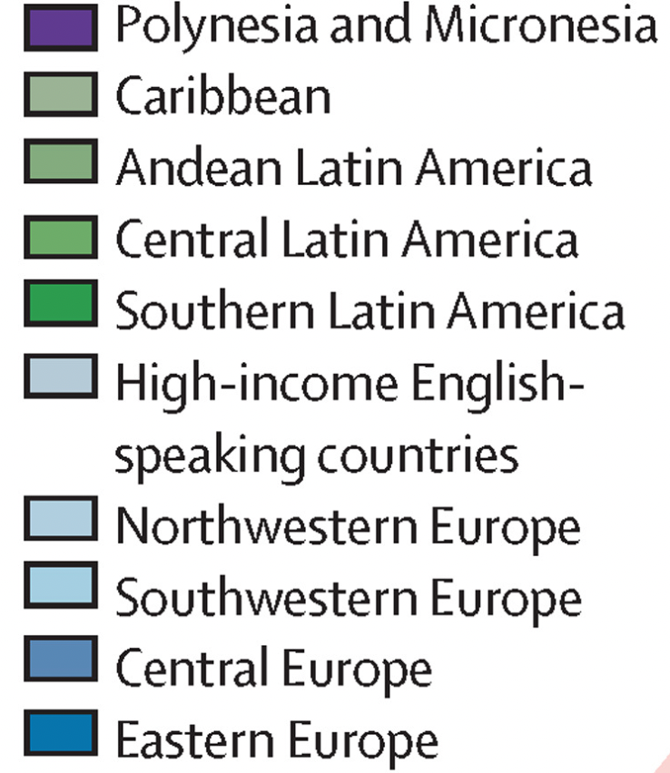
Obesity: the emerging epidemic
T2D Incidence at ages 10-20 years
(Per 100,000 population)
1980
1990
2000
2010
NCD Risk Factor Collaboration (NCD-RisC), Lancet 390, 2627–2642 (2017)
Wagenknecht et al, The Lancet Diabetes & Endocrinology 11, 242–250. (2023)
Notes:
prevalence of youth-onset T2D…inc worldwide….partially attr’ed to childhood obesity…one ex of incidence of obese children in past 4 dec
While obesity prevalence increase in both sex…metabolic comp’n is different across sexes … little has been done to understand the early asp of obe& meta in adolescents… sex diff start to emerge
While obesity in childhood is highly corded w/ adulthood, and intervention is beneficial at earlier age
Few studies have focused on childhood obesity
https://doi.org/10.1016/S0140-6736(17)32129-3

Slide 3


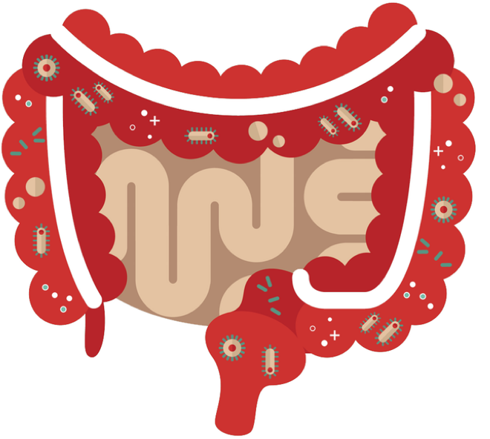
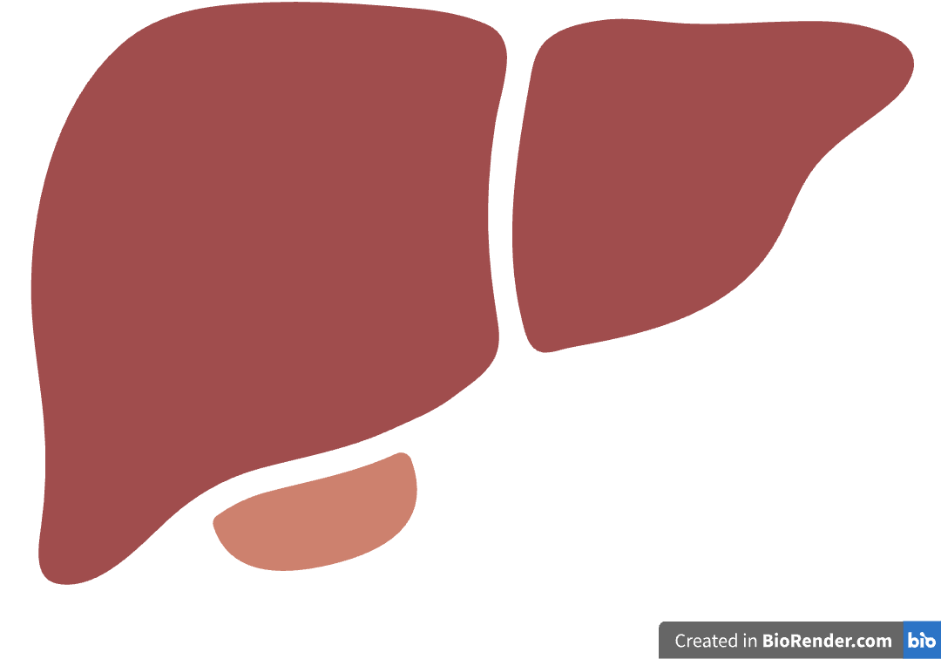
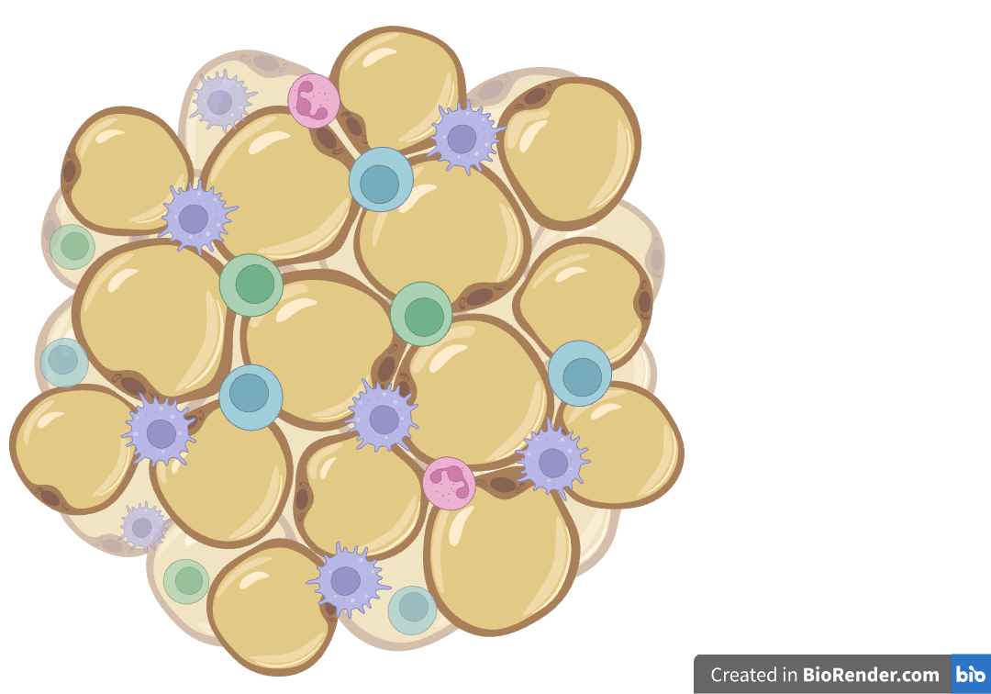

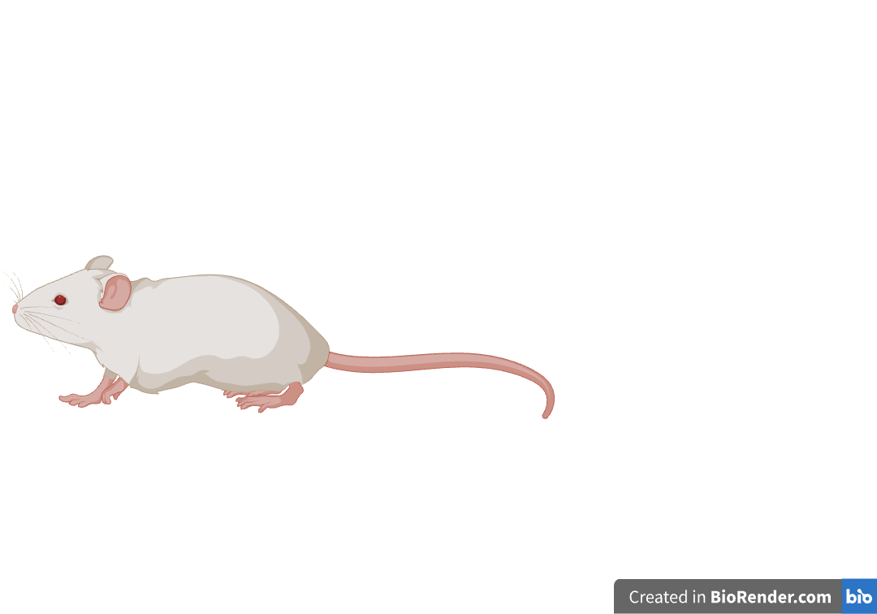
Role of gut microbiota (Mb) in obesity and metabolic dysfunction
Pro-inflammatory immune response
Appetite & satiation
Insulin resistance
Insulin resistance: HOMA-IR
Caloric excess: Triglycerides
Ridaura et al, Science 341, 1241214 (2013)
de Wit et al., Sci. Transl. Med. 15, eadg2773 (2023)
Tilg et al., Nat. Rev. Immun. 20, 40–54 (2020)
Glucose & fatty acid metabolic dysregulation
Notes:
obesity is not a disease…rather a risk factor for meta dysf, not everyone will present w/ metabolic disease
Gut Mb…. important in context of obes & meta disease
`Causal role…obese or lean phenotypes of either humans or mice can be transferred to mice with FMT
Changes in gut mb’a -> ` inflam’n in the gut, Glucose & fatty acid metabolic dysregulation and insulin resistance
Common measures of metabolic dysfunction …Homeostatic Model Assessment for Insulin Resistance & plasma triglycerides … not well defined in adolescents

Slide 4
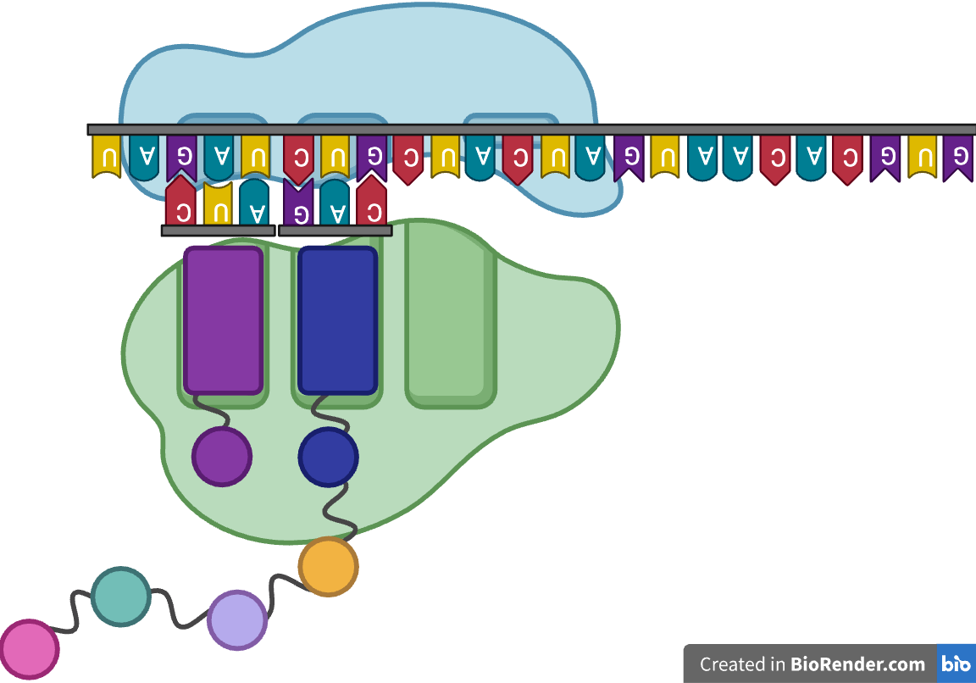




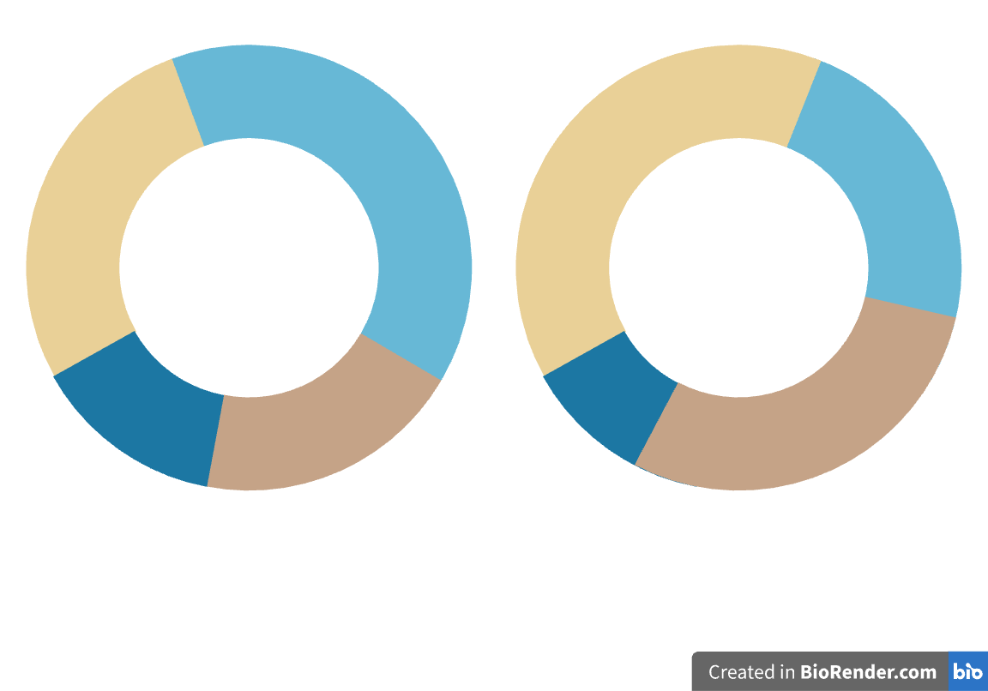
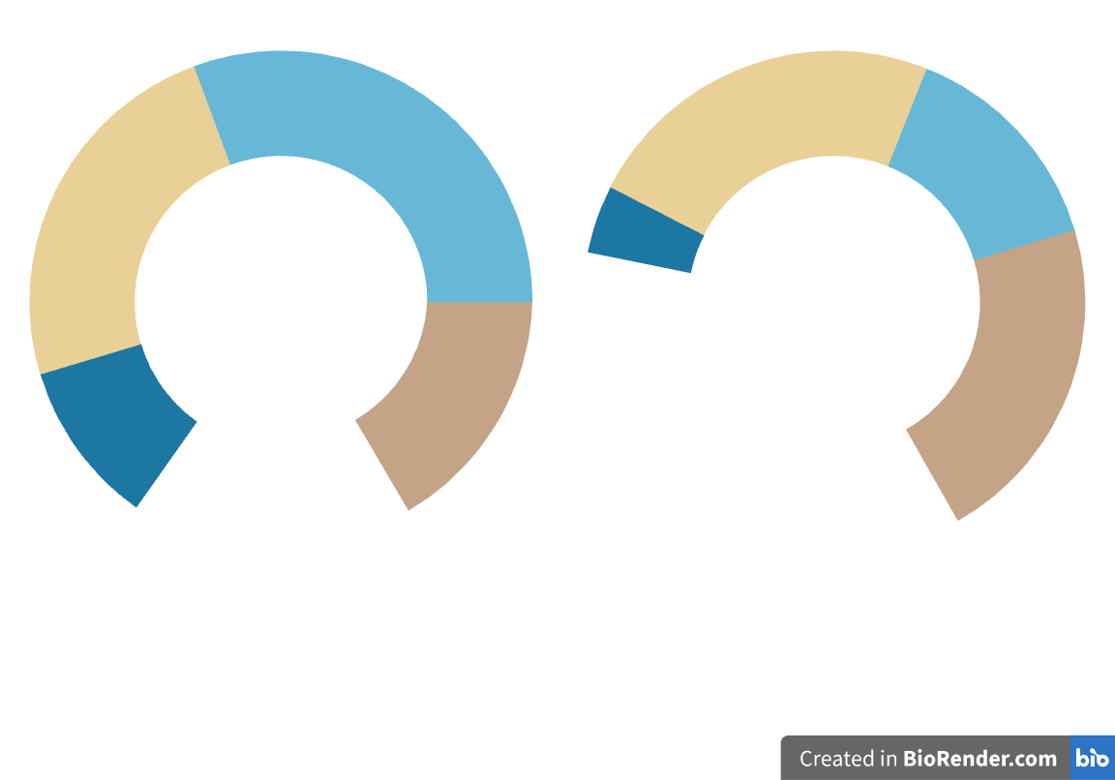

Relative and absolute quantification of microbiome sequencing
Bacteria 1
Bacteria 2
Dead - PI
ATCG
Bacteria 3
Bacteria 4
Bacteria 1
Bacteria 2
Bacteria 3
Bacteria 4
Live - TO
A
B
A
B
Relative abundance: bacteria%
Absolute abundance: # bacteria
Notes:
A standard Mb analysis is to seq variable regions of 16S rRNA
Id of bacteria taxa inferred… mapping 16S seq to a reference library.
Such method gives Mb composition in relative abundance, add up to 100%
altered overall microbiota abundance itself could be a key identifier of a disease-perturbed ecosystem
We developed a method in the lab to convert that to absolute abundance
Enumerate bacteria stained w/ live/dead dyes in wet stool using flow cytometry
Measure water content by … ratio btw weight of wet/dry
In the end get abs abund of Microbiome normalized to per g of dry stool
In IBD … abs abund signf decrease from health ctrl… ass’n w/ certain enterotypes (clustering of distinct gut community compositions)…more pro inflammatory, linked to disease phenotype
We hypothesize that obese individuals will have pro inflammatory response phenotype…same approach

Slide 5




Obese adolescents at risk of Type 2 Diabetes
Inclusion criteria
Age 12 - 18 years old
Age- and sex-standardized BMI ≥97th percentile
Median BMI = 39
n = 56
Goal: to understand risk factors of metabolic dysfunction in obese adolescents
Clinical
Measurements
Plasma
Stool
PBMC
Dr. Jill Hamilton,
Healthy Living Clinic
Notes:
Small cohort but patients followed longit..by JH in …clinic @ Sickkids..for a holistic patient centred approach for obes manag’t. Participants recruited based on having ≥97th percentile for age and sex … WHO growth chart
We took some clinical metadata (anthropometric & metabolic measures) and bio-specimen for a cross-sectional study to ‘understand risk factors of meta dysfu’n in obese adolescents

Slide 6
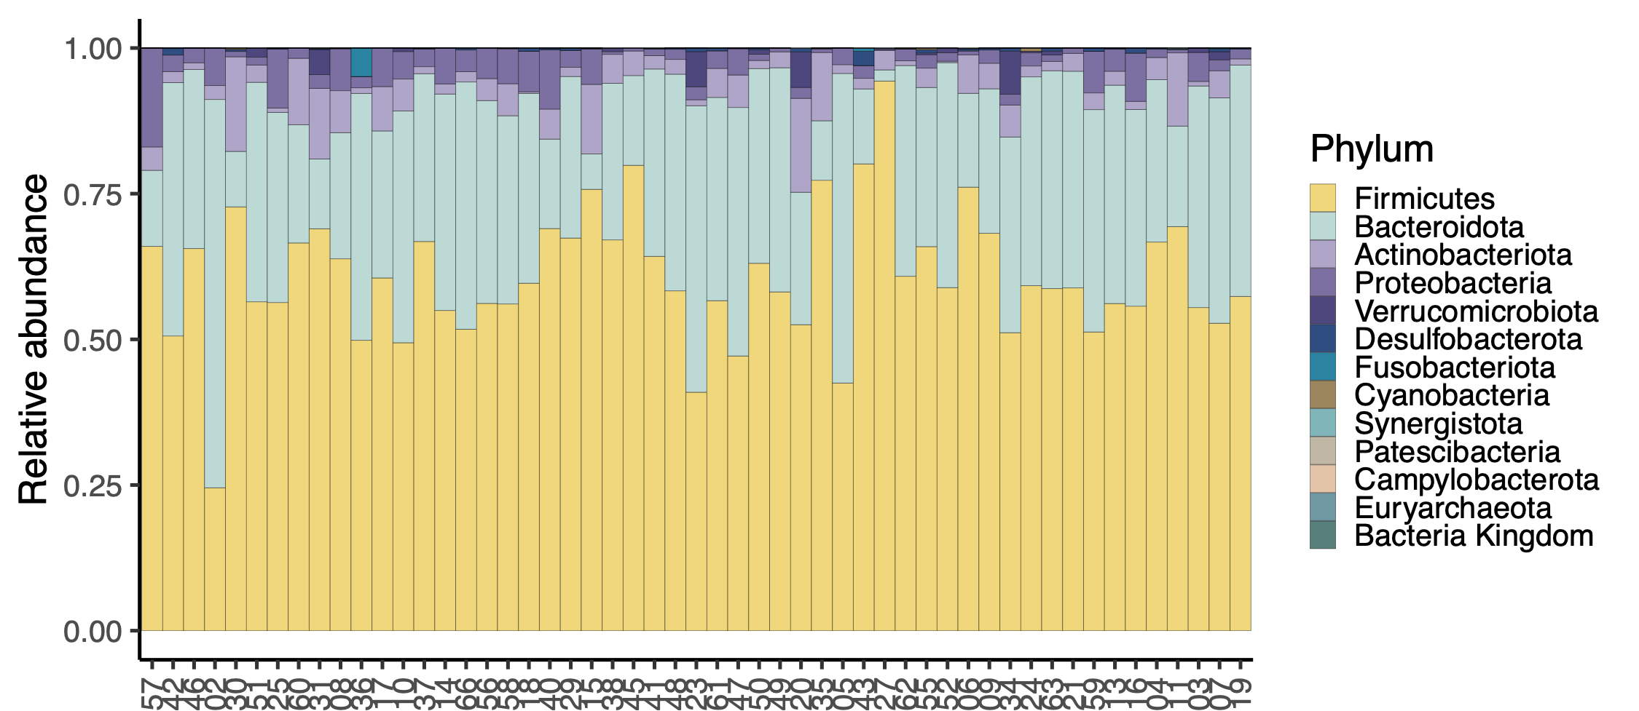
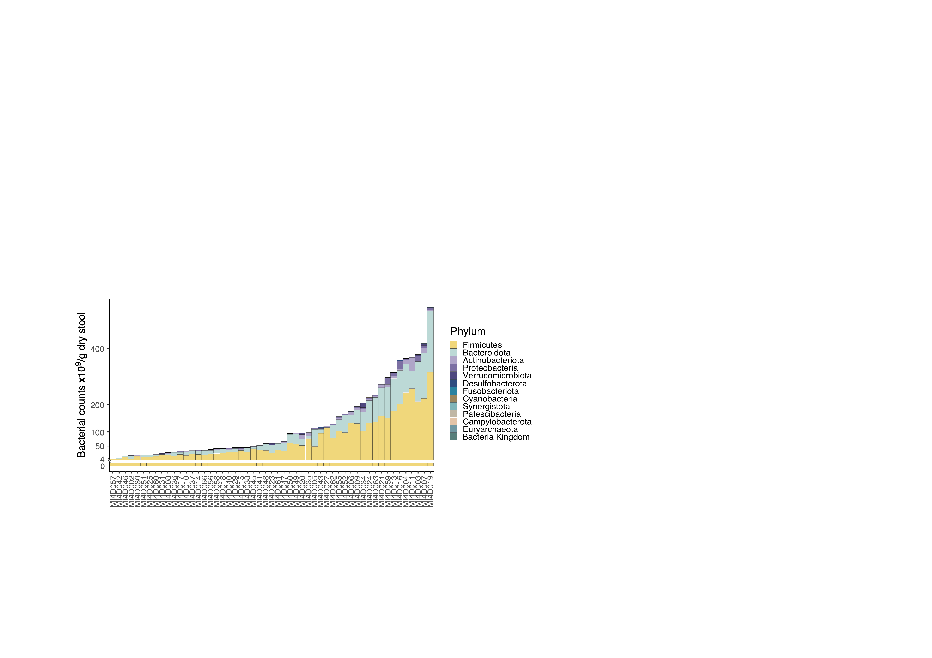
Analysis of the gut microbiome of obese adolescents
1
2
3
4
5
6
7
8
9
10
11
12
13
14
15
16
17
18
19
20
21
22
23
24
25
26
27
28
29
30
31
32
33
34
35
36
37
38
39
40
41
42
43
44
45
46
47
48
49
50
51
52
53
Multi-log order differences
in fecal bacterial abundance
3.8x10⁹ – 5.5x10¹¹ bacteria/g dry stool
1
2
3
4
5
6
7
8
9
10
11
12
13
14
15
16
17
18
19
20
21
22
23
24
25
26
27
28
29
30
31
32
33
34
35
36
37
38
39
40
41
42
43
44
45
46
47
48
49
50
51
52
53
Sample ID
Sample ID
Notes:
Left: stacked bar plot…rel abund…phylum: each bar = a participant labeled on x, relative abundance = height of the bar on y
Prev report… ass’n of ratio btw Firmicutes (yellow) & Bacteroidetes (blue) to obesity
composition of Mb similar across participants, can’t distinguish obv subgroup among participants
Bar plots of Mb composition …in same order…scaled by absolute quantification of bacteria in stool, `we saw multi-log order diff in fecal bact load in the absence of intentional perturbations of gut microbiota (e.g. antibiotics treatment).
This is signi…no study done on absolute quant of bacteria in adolescents …. No reference on abs abund in healthy adole or expected magnitude of diff… looking to collaborate to port this approach to independent cohorts
Ass’n w/ gut Mb diversity…dk normal gut Mb look like…↓ Mb diversity observed in disease context

Slide 7
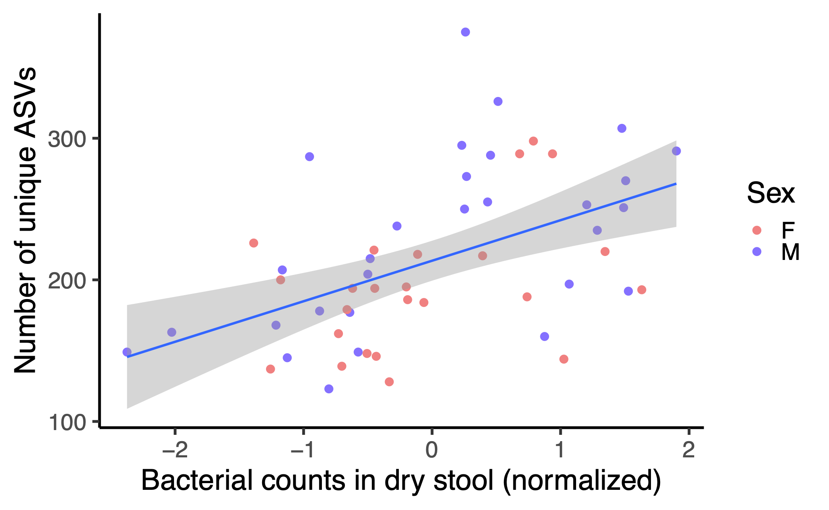
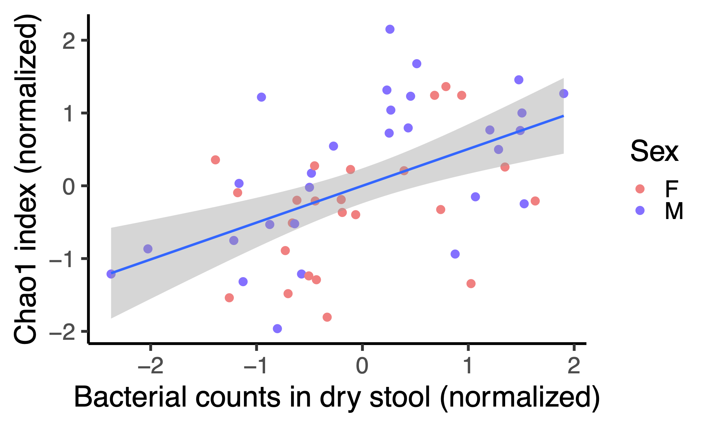
Absolute bacteria abundance associated with gut microbiome diversity
bacterial diversity # bacteria taxa
p = 8.45 × 10⁻⁵
p = 0.0001
taxa
Notes:
scatter plots of 2 measures of gut MB diversity: Chao 1 (mean taxa diversity w/i indiv), # unique taxa … against bacteria counts
the diversity of the bacterial community in the gut … absolute abundance of gut microbiota
Same effect across sex
Chao 1: richness
Also Shannon's diversity: richness and evenness

Slide 8
Difference in absolute abundance: intrinsic to gut Mb or host influence
ATCG
 | High | Low
F | 11 | 13
M | 16 | 13
High biomass
(n=4)
Low biomass
(n=4)
Dead - PI
Live - TO
Granato, Yau and Kong et al. (2023) submitted
Notes:
A property of the gut Mb or influenced by host?
Stratified cohort … median fecal bacteria counts …. 5.9x10^10 bacteria/g dry stool
fecal innocula… 4 representative high- and low- biomass participants
`a continuous flow, microprocessor-controlled bio-reactor (chemostat)…. human distal colon…pH, media nutrients and flow rate
`Absolute and relative quantitation of the output of the culture
Two-way table

Slide 9
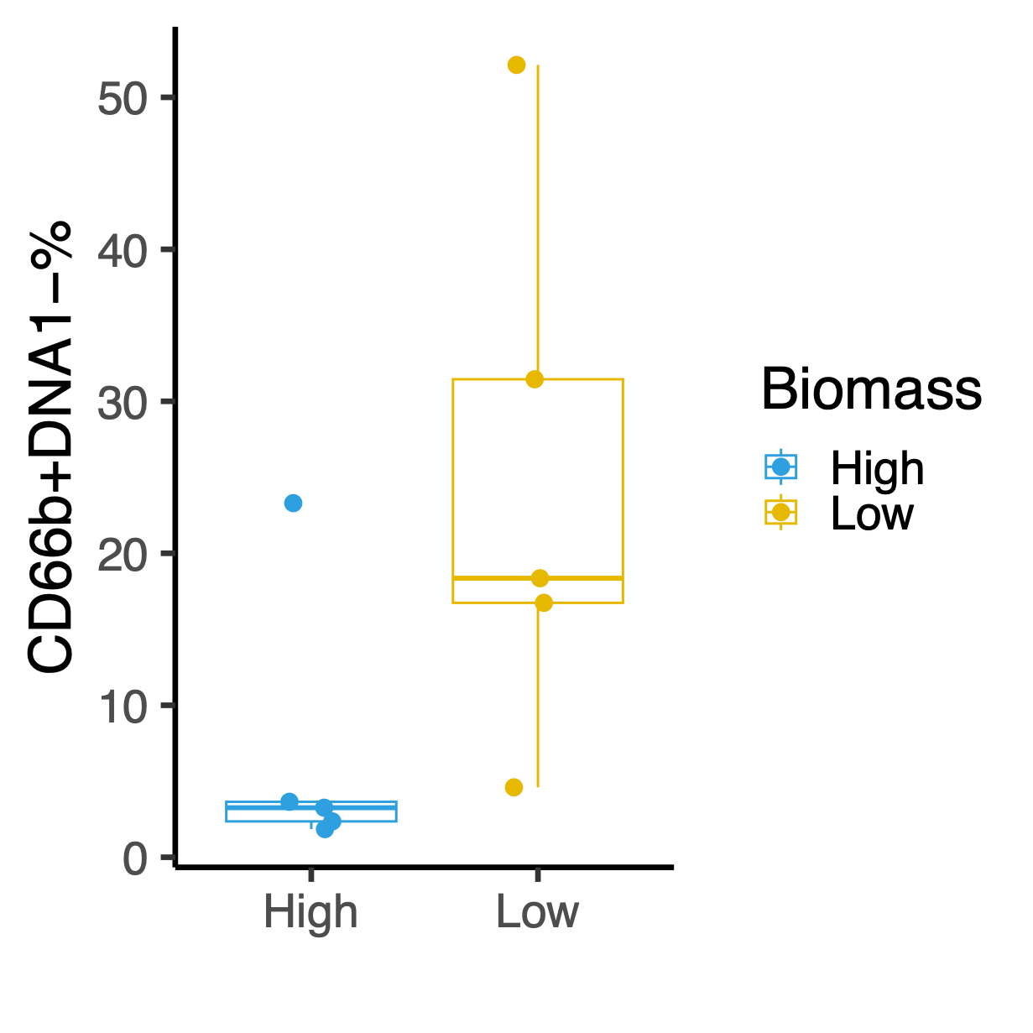
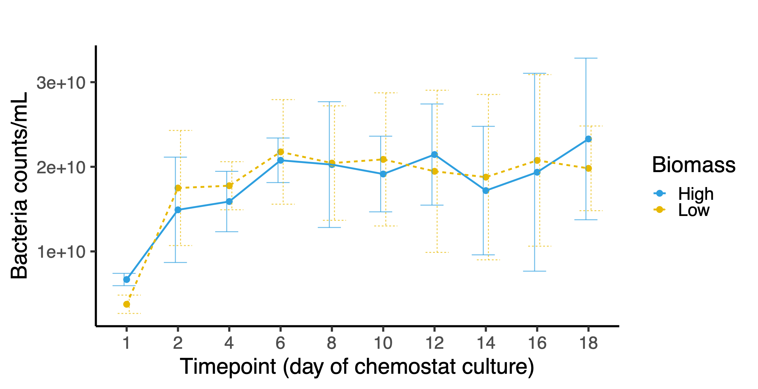
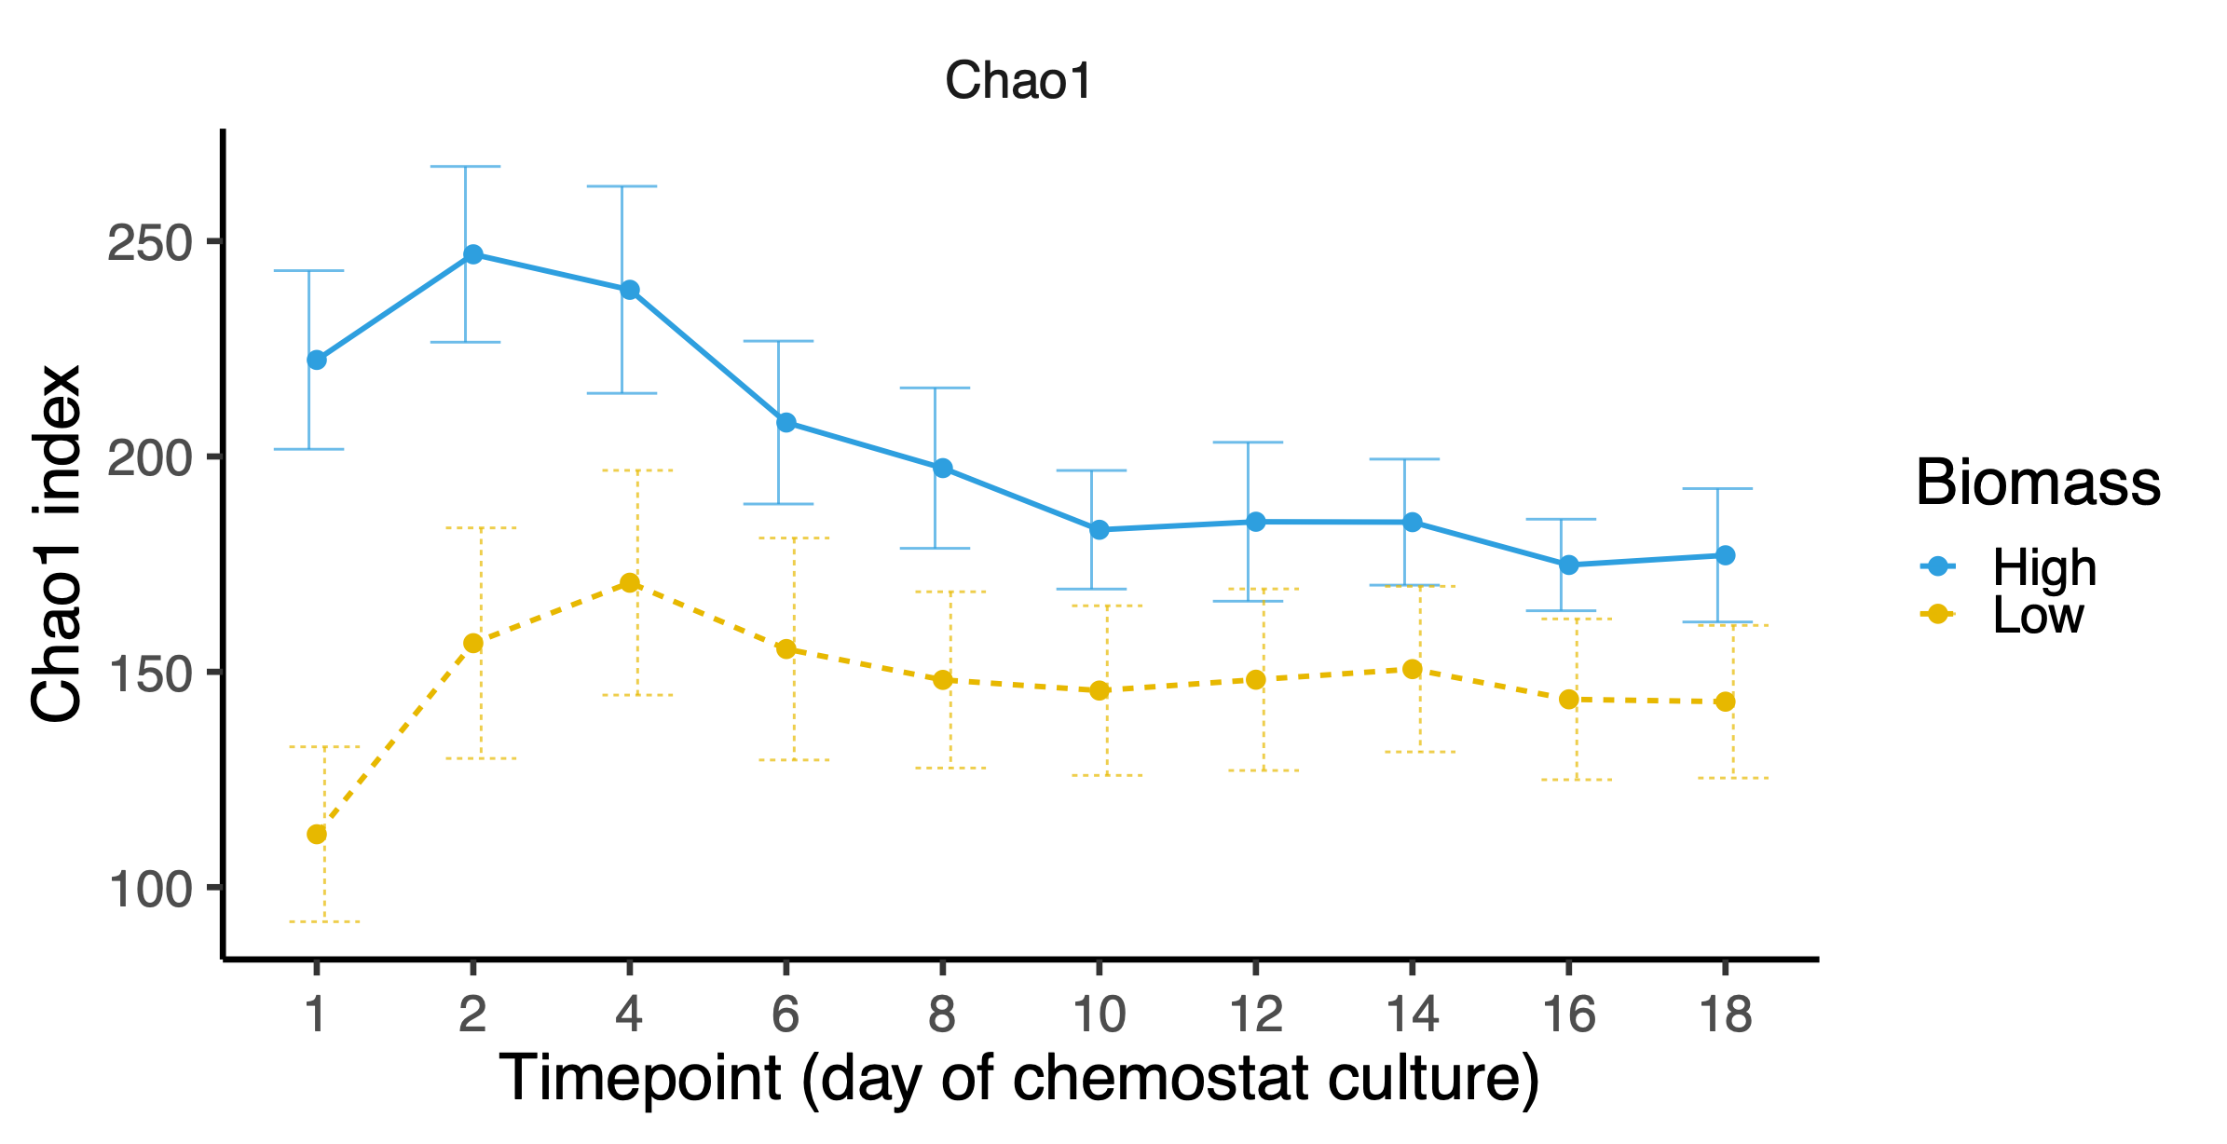
Bacterial biomass is a host-dependent feature
bacterial diversity
absolute abundance
p < 0.001
p = 0.9
Notes:
Line graph showing a diversity of chemostat culture over 18 day period, dot - mean of biomass group, error bar sd, blue high, yellow low
chemostats preserved richness of host gut Mb…cultures derived from high biomass participants.. end up higher diversity
However… when look at bacteria density in chemostat culture…diff in absolute bacteria abundance not recapitulated
Conclude

Slide 10
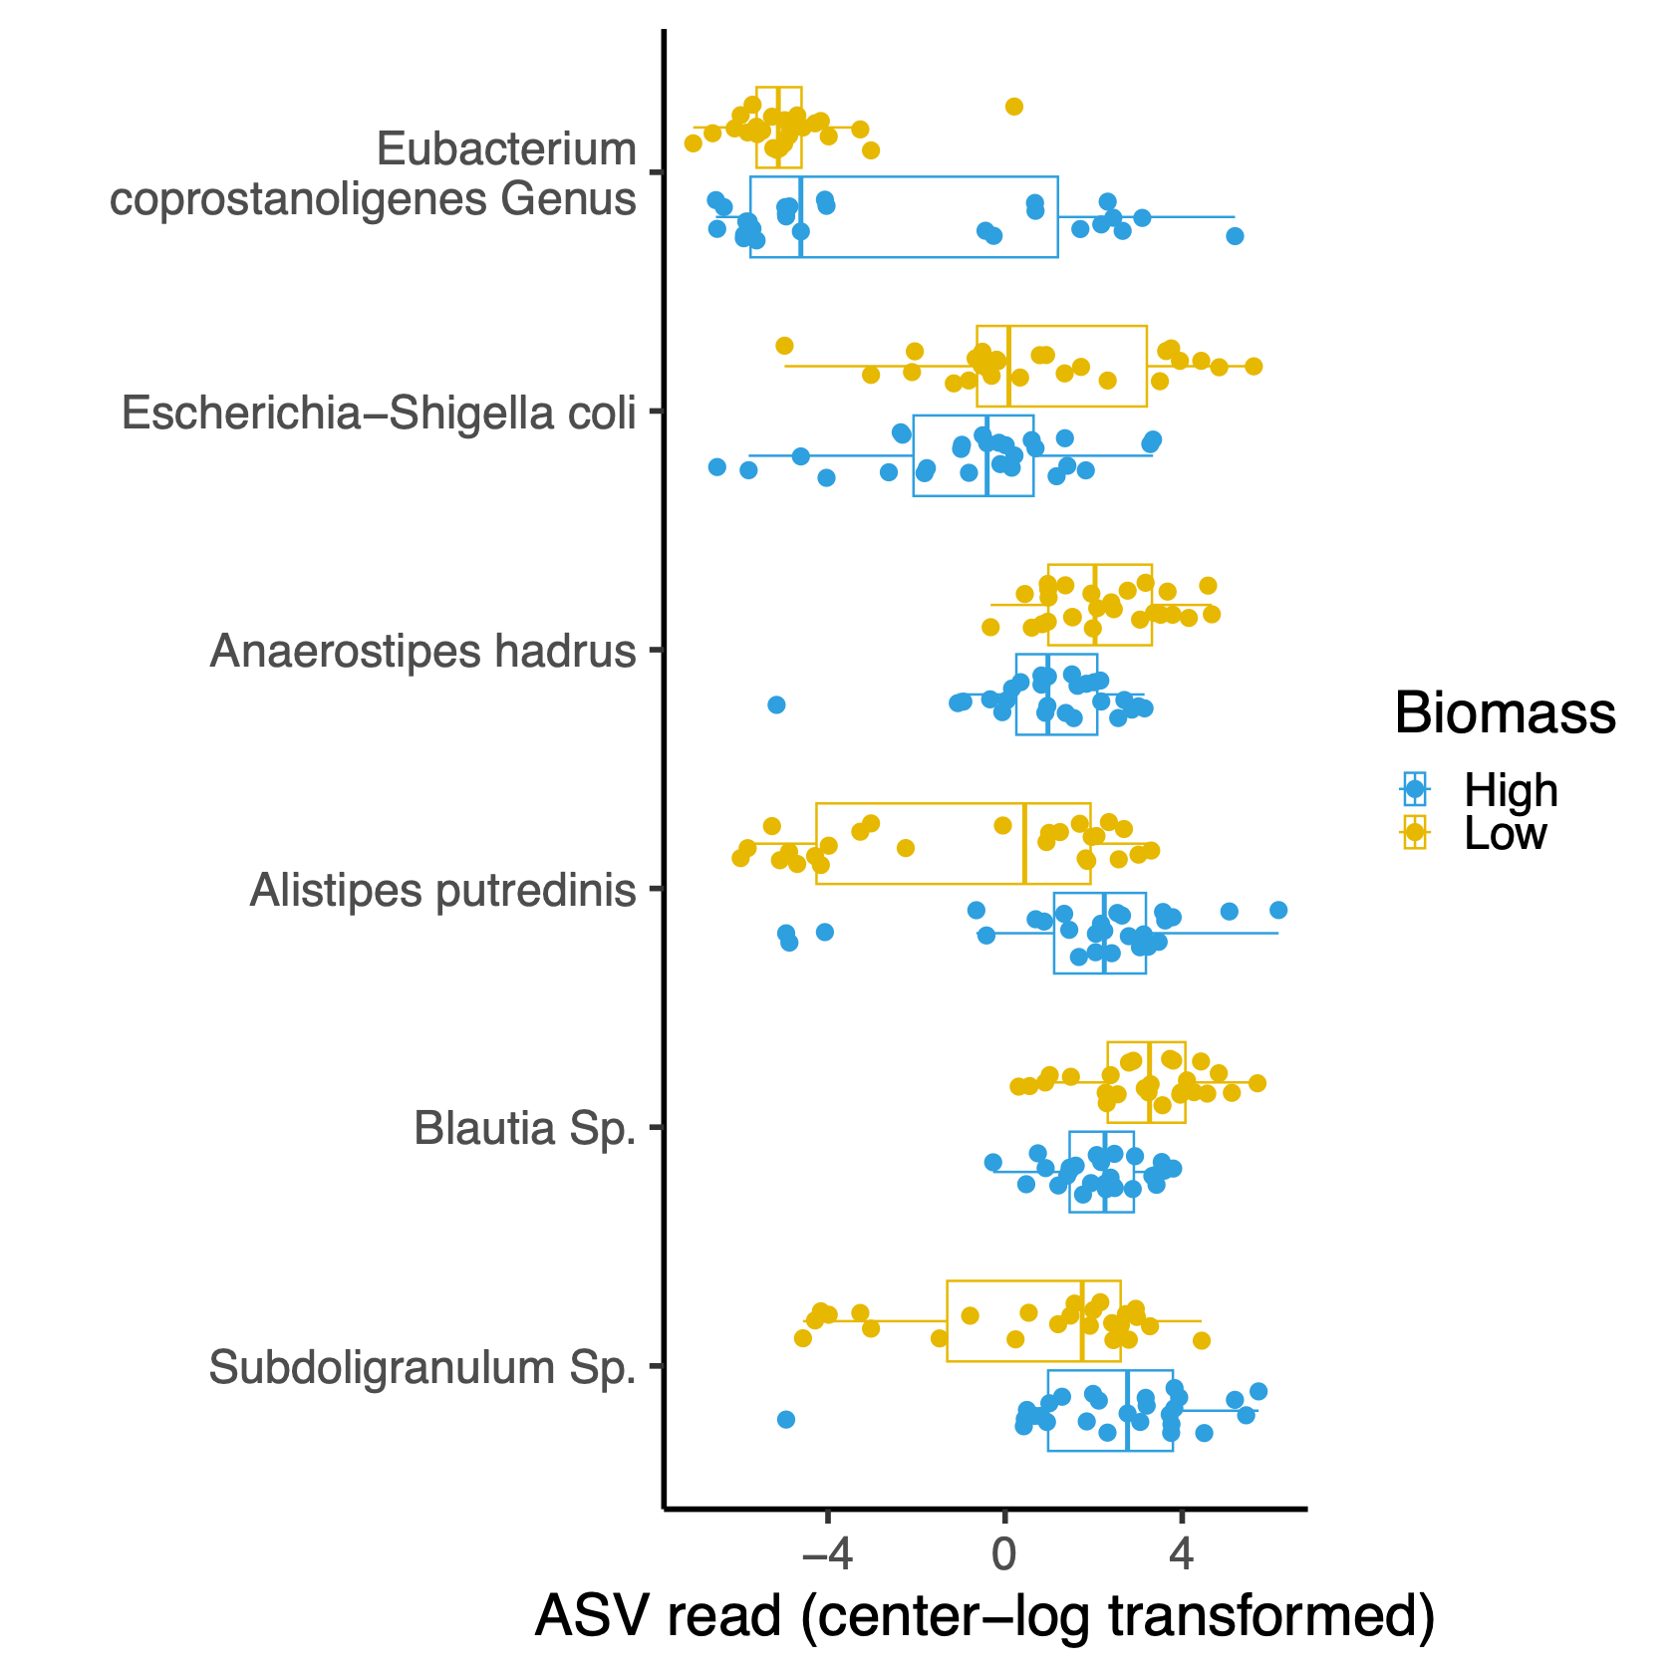
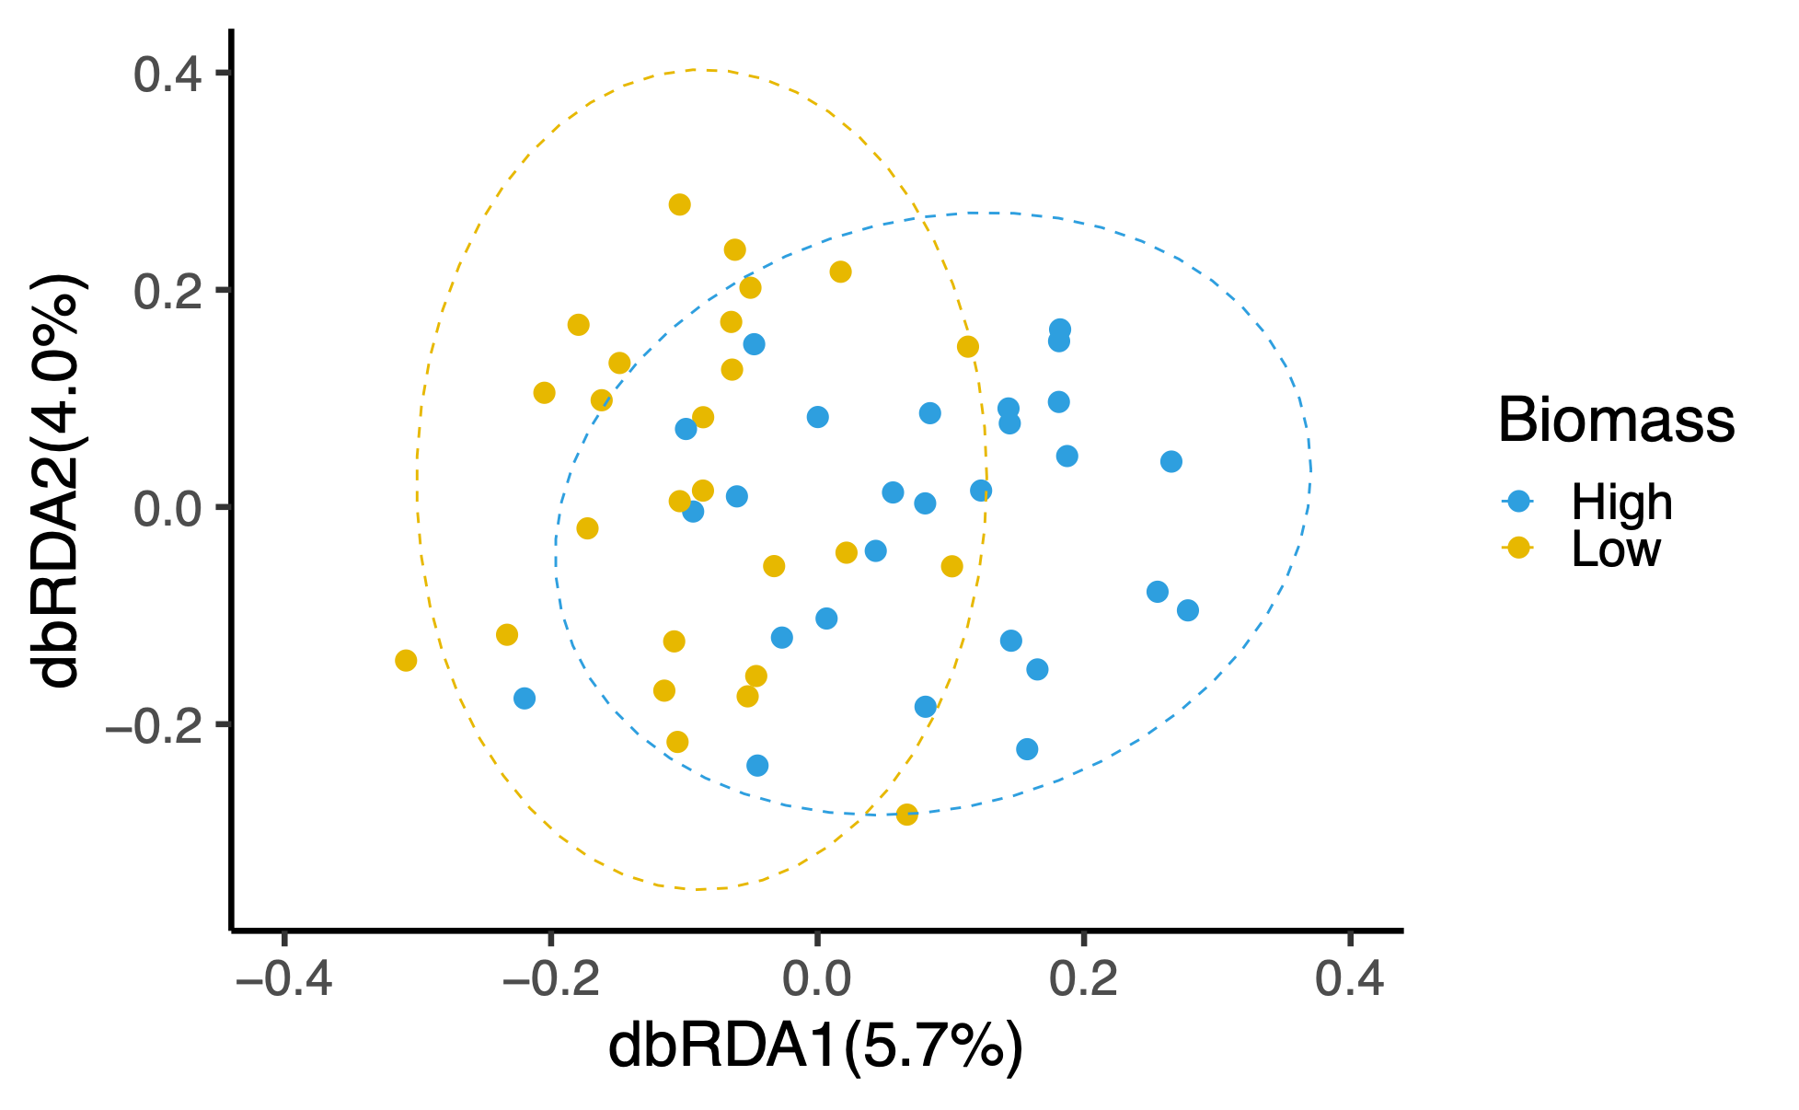
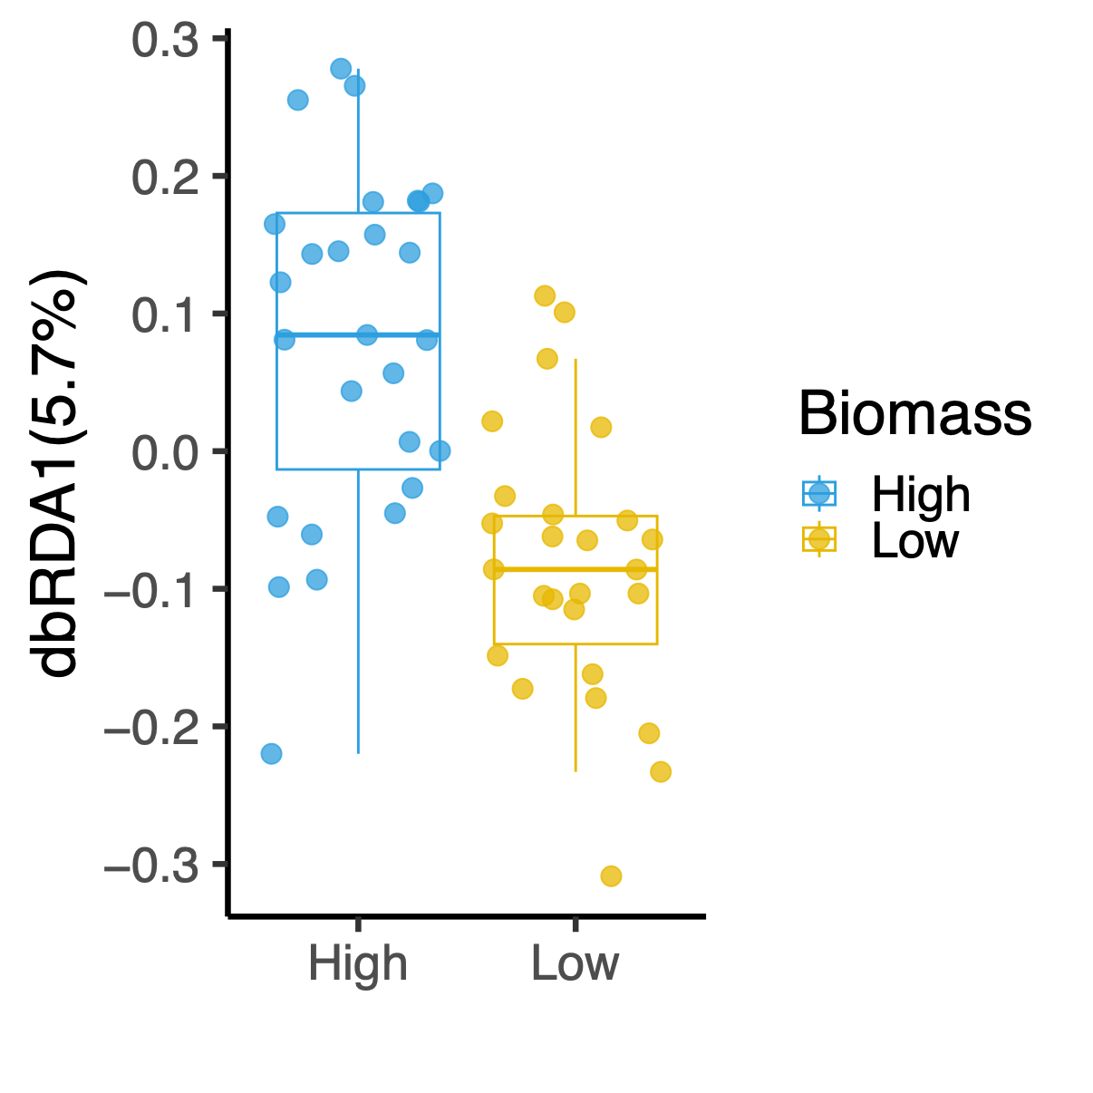
Fecal biomass associated with gut microbiome variance
p.adj < 0.05
p = 0.0007
Bacteria abundance
(centred & transformed)
Notes:
To identify patterns that drives diff in this cohort.. a dimension reduction analysis
point = participant w/ diff rel abund of bacteria taxa , ellipse = 95% CI of t distribution of each biomass group
we stratify participants based on high/low biomass.. see significant diff in mb composition
difference in biomass … `most evident …projected on dbRDA1…summarized in boxplot middle
Test for diff in abund in top 20 taxa …. these ARE sign diff
Names…consistent with literature … shigella is pathobiont & inflam’n (higher in low)…. Alistipes increased after FMT attenuated weight gain…Blautia decreased after bariatric

Slide 11
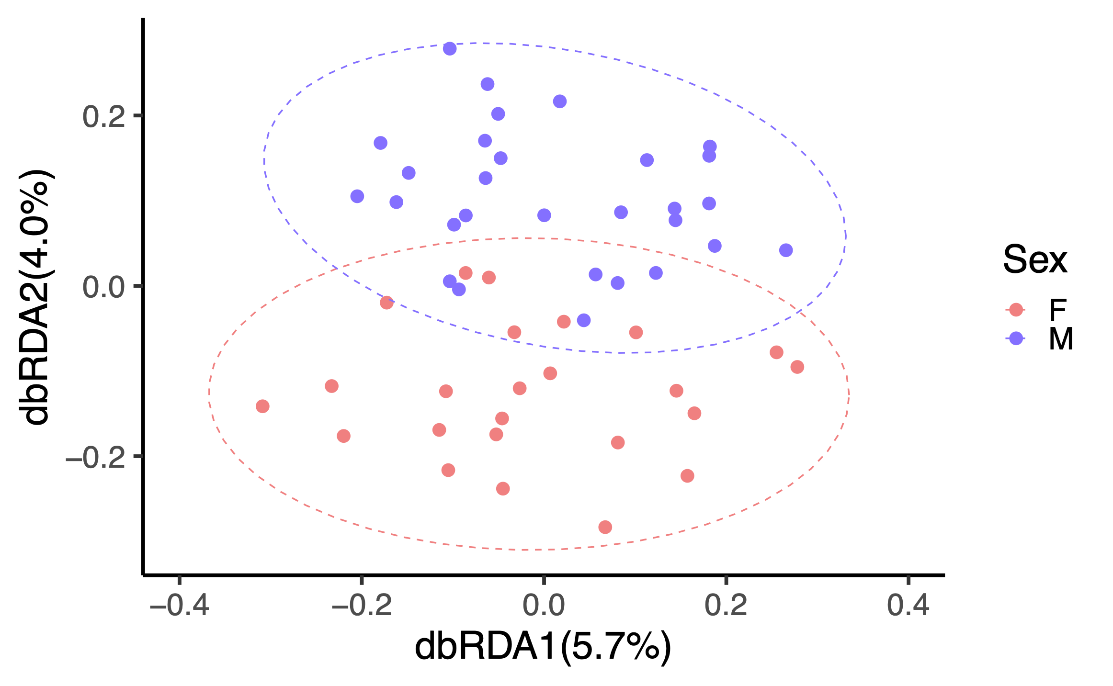
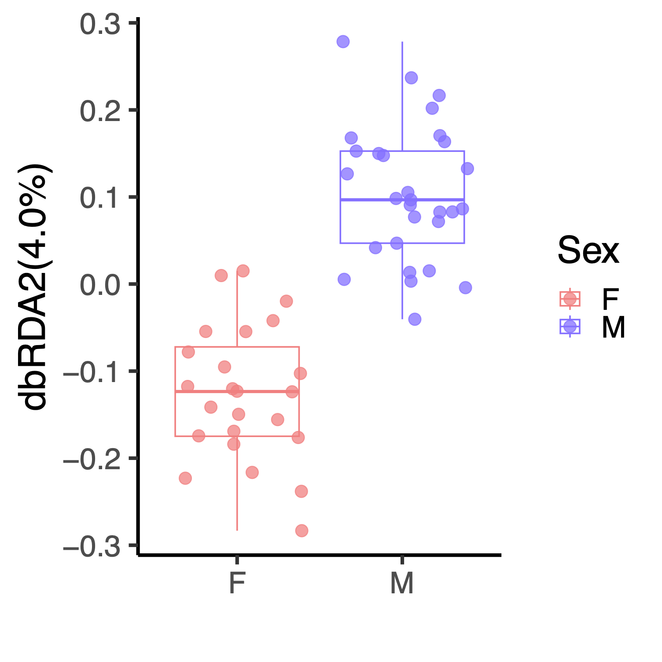
Sex associated with gut microbiome variance
p = 0.001
Notes:
Import to look b/c…sex differences in the gut microbiome exist at the taxonomic level… e.g. Bacteroides -ve ass’ed w/ BMI in males
diet also has sex-dependent effects on the gut microbiota
Same plot, coloured differently by sex … exp sign variation in Mb composition … most evident …projected on dbRDA2

Slide 12
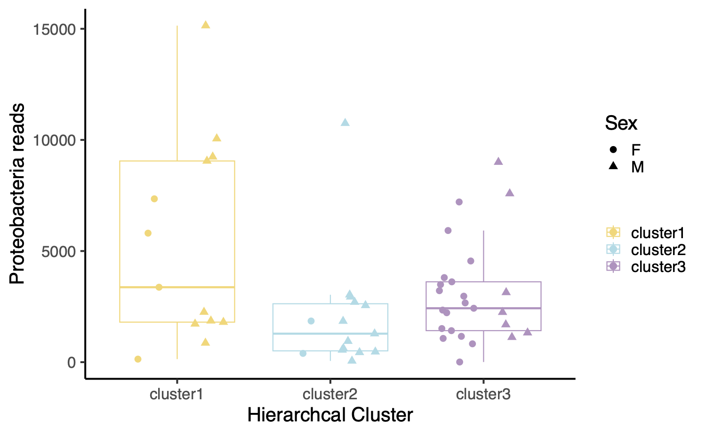
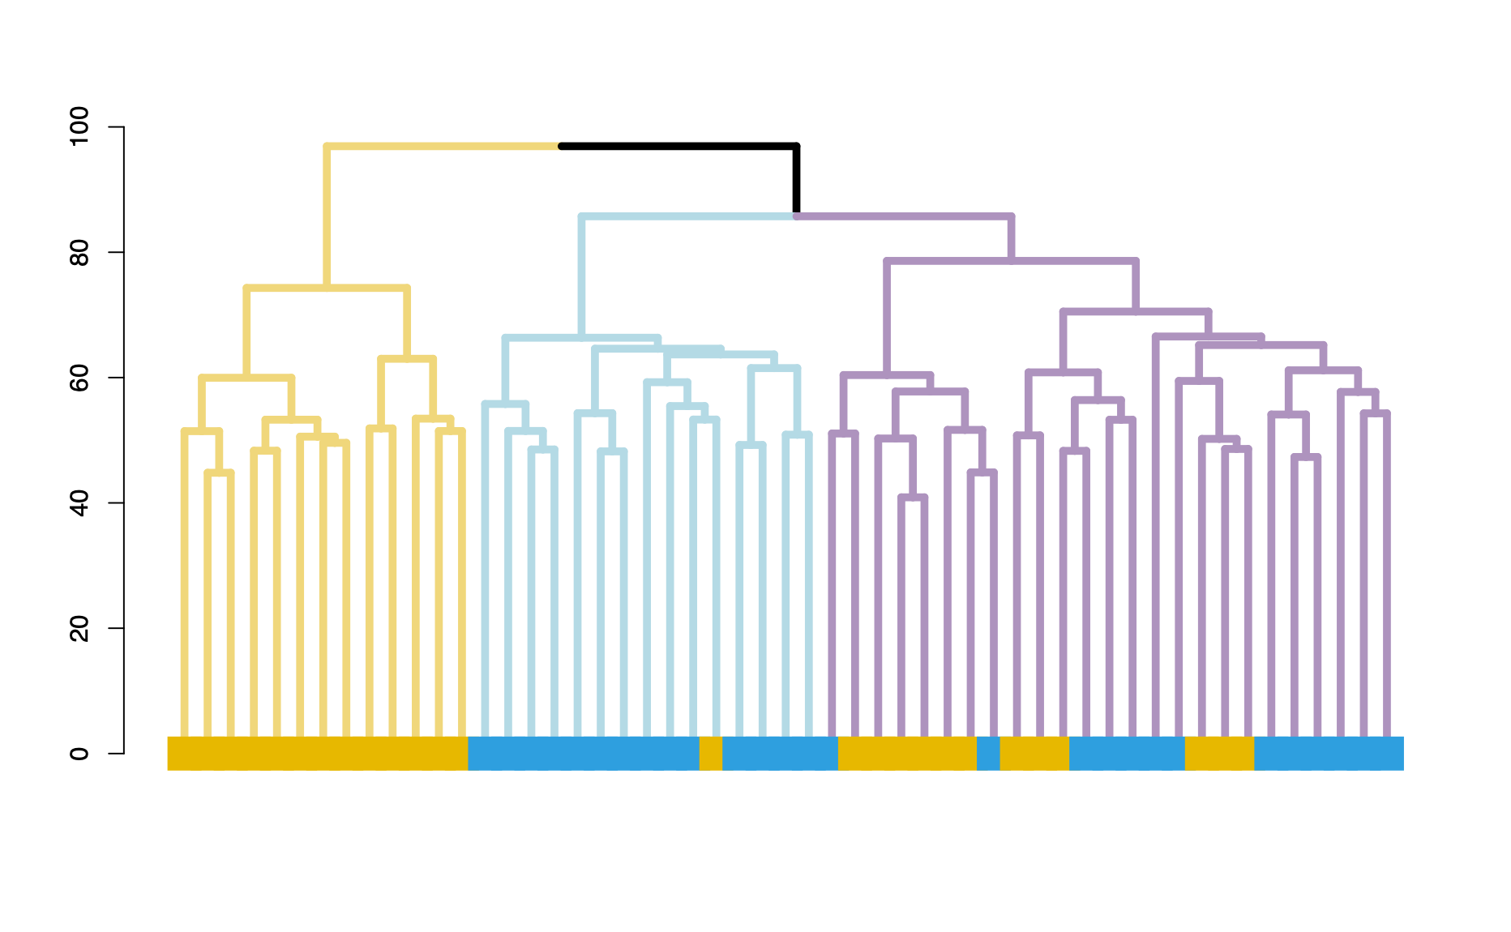
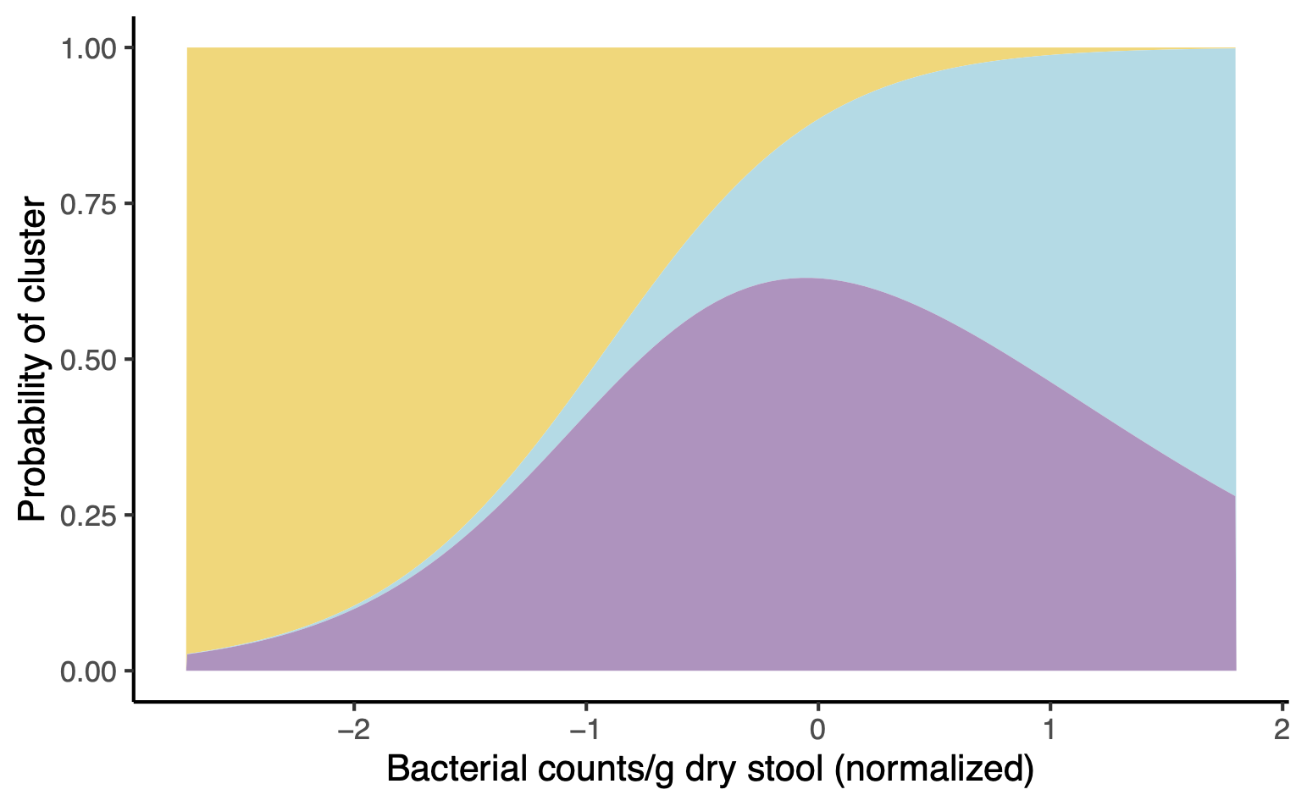
Clustering of gut microbiome correspond to bacterial biomass
Clustering of gut microbiome from all individuals
one-way ANOVA
p = 0.022
Biomass
Cluster 1
Cluster 2
Cluster 3
Notes:
We performed clustering based on rel abun of taxa … a granular look at …var’n in Mb (ass’ed w/ bact biomass )
Cluster 1 (yellow) … exclusively low biomass, cluster 2 (blue) … high biomass, cluster 3 …in middle
compared to cluster 1…the relative abund… lower in cluster 2 & cluster3
Several proteobacteria genus enriched in cluster 1
Shigella - opport pathogen, third most commonly isolated bacterial enteric pathogen
Sutterella - IBD, mild pro-inflammatory activity, IgA-degrading capacity
Parasutterella - BMI, T2D, FA biosynthesis, cholesterol metabolism
multinomial logistic regression … prob of cluster assignment based on fecal bacteria counts
Indiv w/ extreme low biomass.. exclus assigned to cluster 1, prob of assigned to 2&3 divided when biomass go up

Slide 13
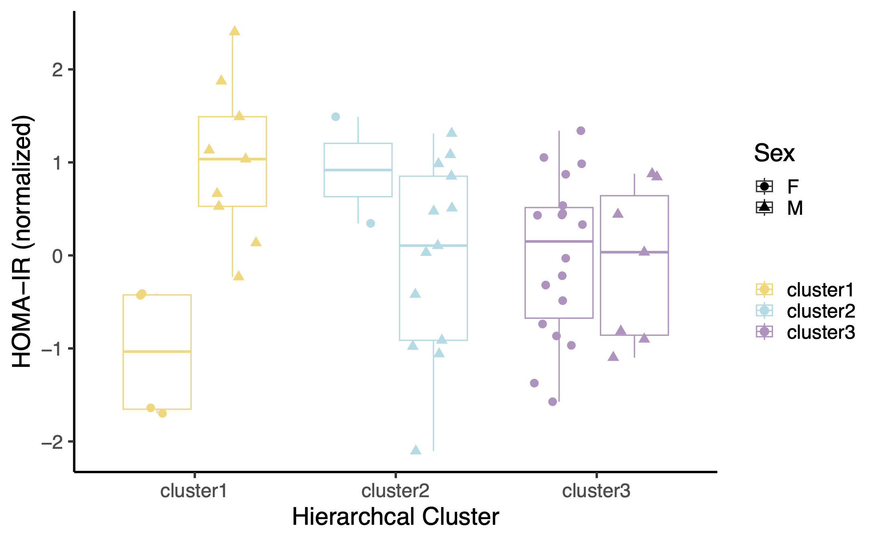
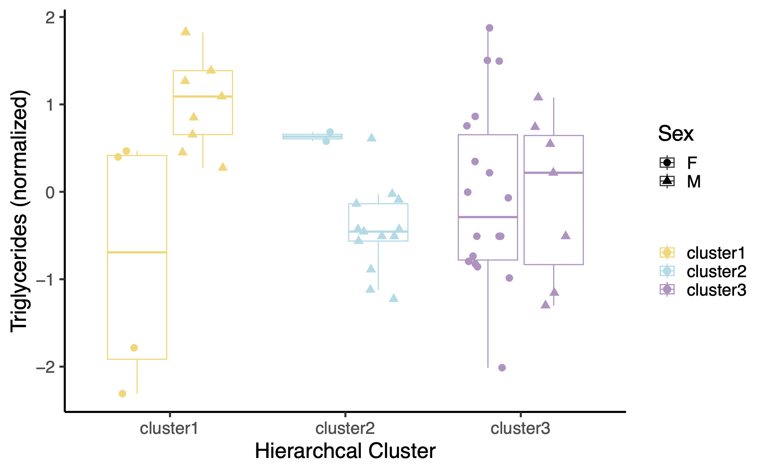
Difference in cardiometabolic measures across microbiome clusters & sex
Insulin resistance Plasma triglycerides
Sex p=0.0005,
Cluster 2 p = 0.024,
Cluster 3 p = 0.045,
Sex-Cluster 2 interaction p = 0.002,
Sex-Cluster 3 interaction p = 0.004
Sex p=0.0005,
Cluster 2 p = 0.030,
Cluster 3 p = 0.079,
Sex-Cluster 2 interaction p = 0.0007,
Sex-Cluster 3 interaction p = 0.004
Notes:
individuals assigned to these clusters … diff in cardio-metabolic fitness
Boxplot showing two cardiometabolic measures stratified by cluster & sex
Left: cluster 1 males … lower biomass….higher insulin resistant than females…higher degree of meta dysreg’n
cluster 2 and 3 … higher biomass.. males lower insulin resistance score
despite relatively small cohort… robust stat for sex diff …in all three clusters in ass’n w/ meta dys…masked in the whole participant group
Male ….more adversely affected by low biomass phenotype & carrying the pop’n of bact we see in enriched in low biomass … given the metabolic measure
Next challenges … apply the same approach in indep & larger sample sets of obese adoles … these associations hold elsewhere

Slide 14
Neutrophil activities associated with bacterial biomass
p = 0.097
Dr. Cynthia Guidos & Tina Chen,
Centre for Advanced Single Cell Analysis at Sickkids
Notes:
We did a high-para immunophenotypic ana w/ ~40 markers to try to disti’n in pop’n of PBMC btw low&high biomass … most pop’n no diff in freq, noticed a neutrophil signature in the low biomass
Not the best platform for characterizing neutrophils… tried to evaluate other neutrophil-specific parameters using plasma

Slide 15
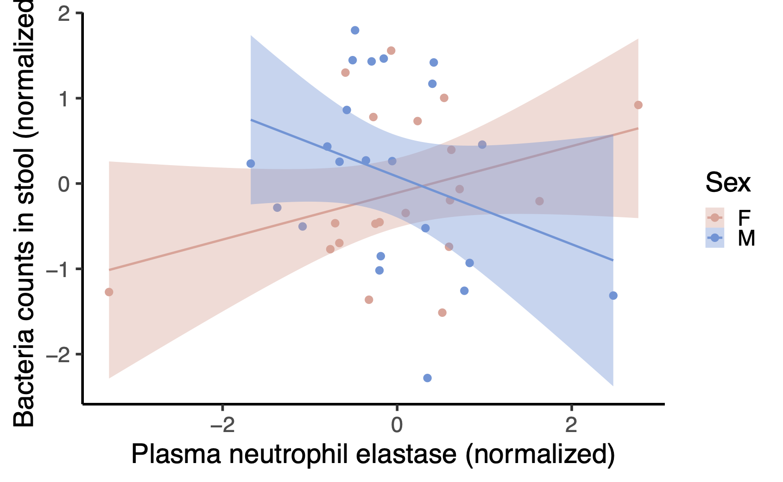
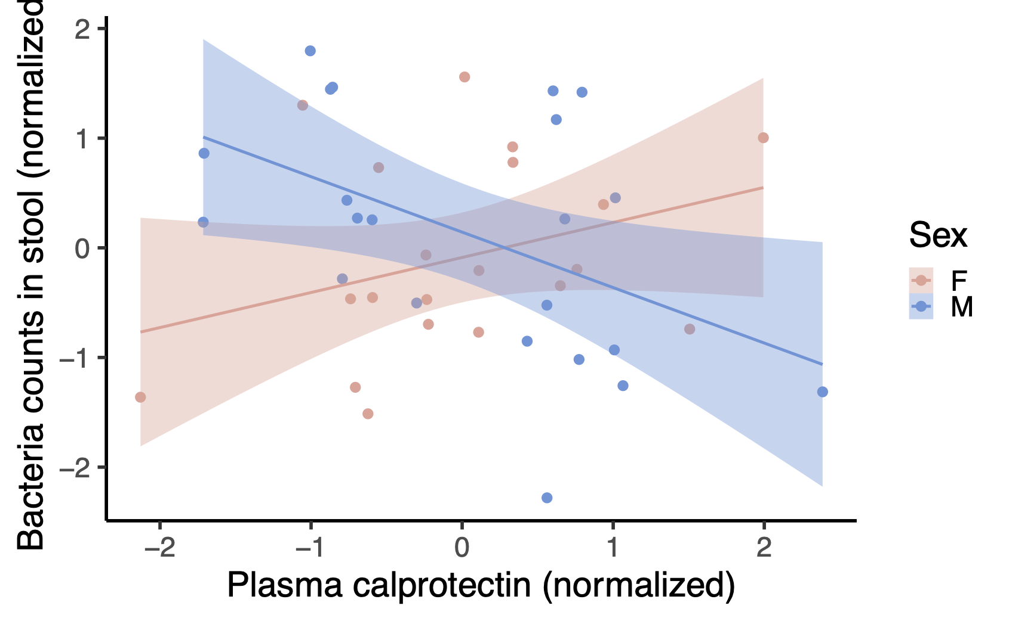
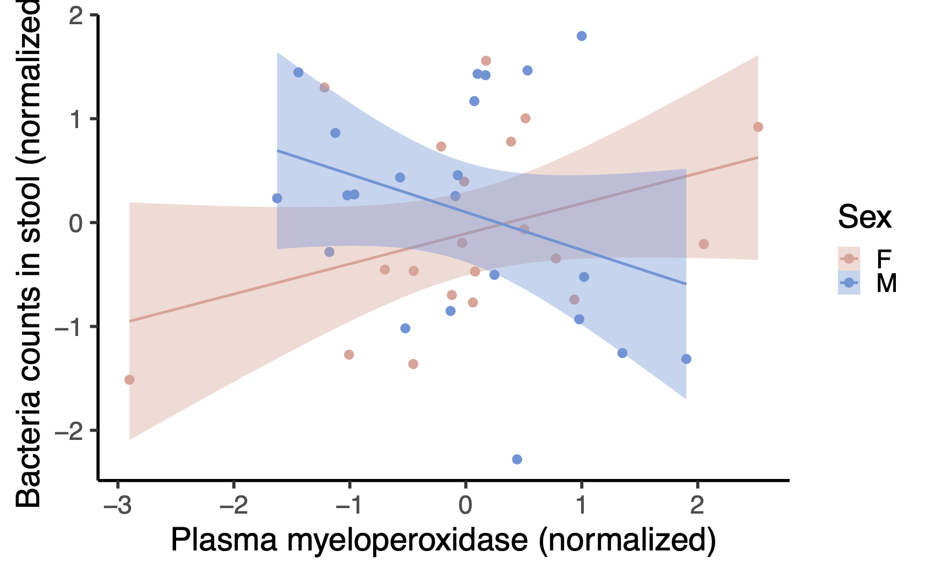
Neutrophil proteins associated with bacterial biomass in a sex-specific manner
Male
Female
Sex-neutrophil-protein interaction
p = 0.02
p = 0.01
p = 0.03
Notes:
we quantified 3 neutro proteins … immune defense against bacteria
elastase, calprotectin, and myeloperoxidase
Scatter plot … protein level on x, bacteria counts on y, coloured by sex
Male… a pronounced negative association between fecal biomass and inflammatory neutrophil proteins in the plasma
The same bact abund in male vs female elicit diff neutro acti

Slide 16
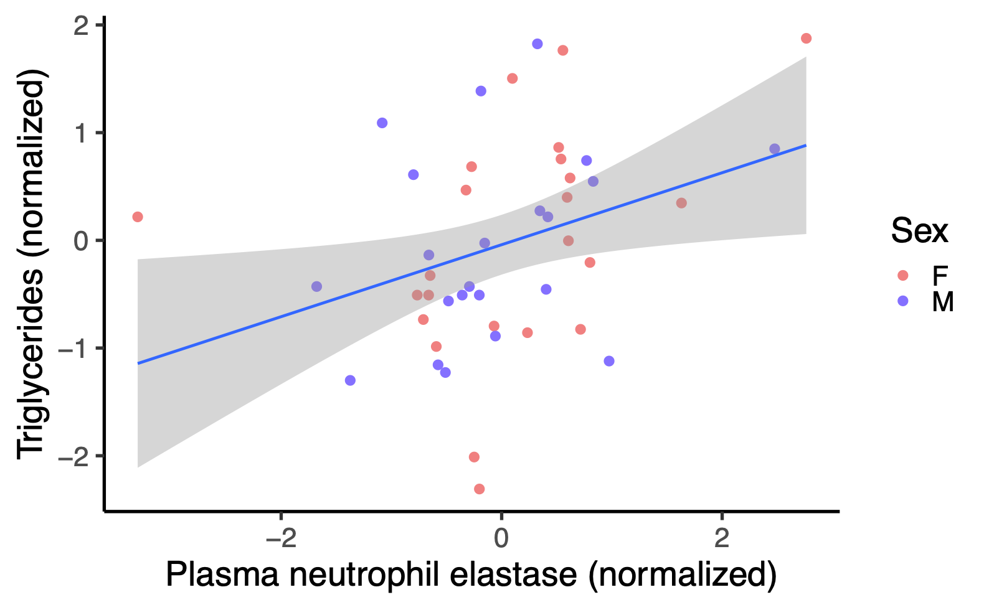
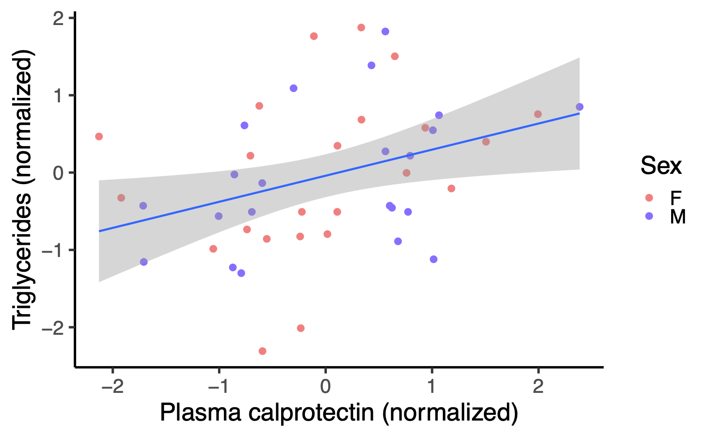
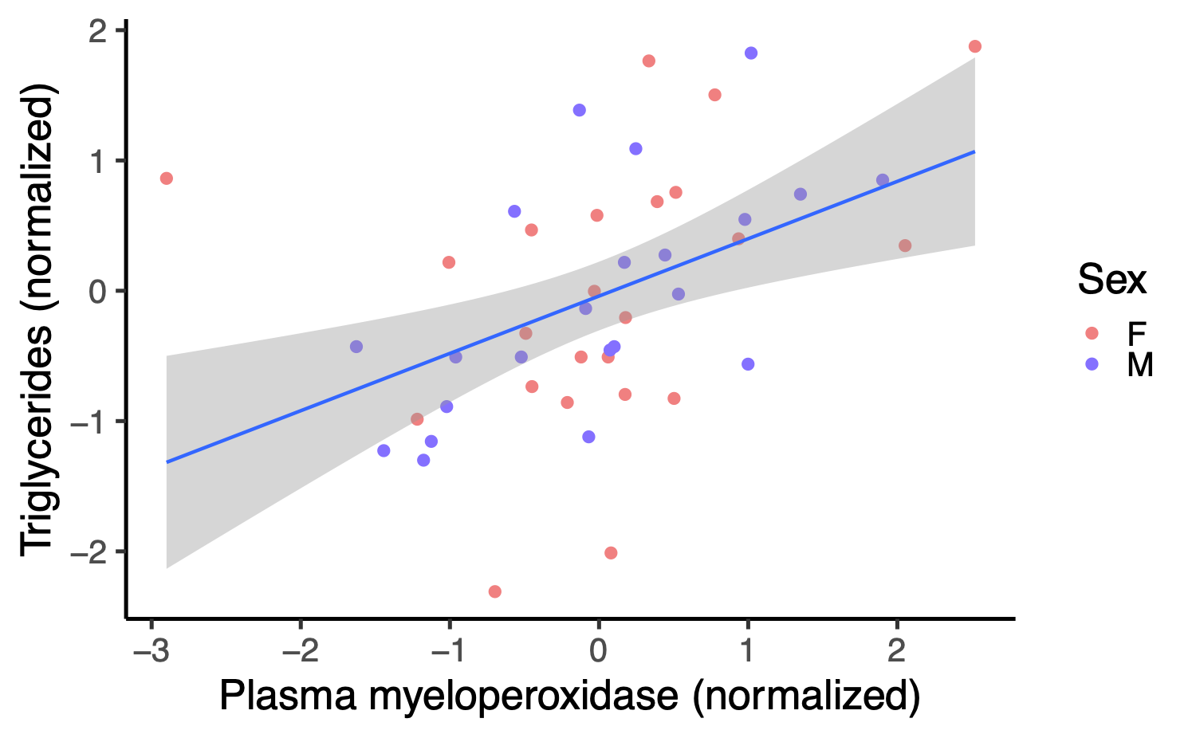
Neutrophil activities associated with higher triglycerides in both sexes
Neutrophil protein p = 0.02
p = 0.02
p = 0.004
Notes:
All three neutrophil proteins are positively ass’ed w/ metabolic dysfunction…here same direct’n of effect in M&F… absolute quant’n of Mb… allow disting btw males & females…neutrophil act’n under these cond — low biomass, obes, meta dysf — more of a property in males than females

Slide 17
Conclusions
Multi-log order variation in bacterial biomass present in an obese adolescent cohort
Absolute bacterial biomass revealed significant different in gut microbiome composition within the cohort, and association of gut microbiota cardiometabolic measures
Association of bacterial biomass to cardiometabolic dysfunction and immune markers are sex-specific. In male participants, lower bacteria biomass associated with greater metabolic dysregulation & elevated systemic inflammation attributed to neutrophil activities
Notes:
By using an abs abund measures to characterize Mb, we see multi log-order diff among participants
following that feature allowed us to appreciate diff in composition of these microbes & ass’n to their cardiometa status
interesting/clinically important diff btw male/female adolescents in these associations. In male…

Slide 18
Acknowledgements
Danska Lab
Dr. Jayne Danska
Alessandra de Paiva Granato
Ildiko Grandal
Lukasz Komorowski
Tiffany Kong
Sabrin Mishel
Anthony Wong
Christopher Yau
Centre for Advanced Single
Cell Analysis at Sickkids
Dr. Cynthia Guidos
Tina Chen
MI4D Study Group
Dr. Jill Hamilton
on behalf of the Healthy Living Clinic
Allen-Vercoe Lab
Dr. Emma Allen-Vercoe
Graphics
Biorender
Committee Members
Dr. Andrew Paterson
Dr. Shane Harding
Notes:
I would like to thank people who assisted me in the project.

